Slide 1
Mass-Storage Systems

Slide 2
Mass-Storage Systems
Overview of Mass Storage Structure
Disk Structure
Disk Scheduling
Disk Management
Swap-Space Management
RAID Structure
Stable-Storage Implementation

Slide 3
Overview of Mass Storage Structure
Magnetic disks provide bulk of secondary storage of modern computers
  Drives rotate at 60 to 200 times per second
  Transfer rate is rate at which data flow between drive and computer
  Positioning time (random-access time) is time to move disk arm to desired cylinder (seek time) and time for desired sector to rotate under the disk head (rotational latency)
  Head crash results from disk head making contact with the disk surface
    That’s bad
Disks can be removable
Drive attached to computer via I/O bus

Slide 4

Moving-head Disk Mechanism

Slide 5
Overview of Mass Storage Structure (Cont.)
Magnetic tape
  Was early secondary-storage medium
  Relatively permanent and holds large quantities of data
  Access time slow
  Random access ~1000 times slower than disk
  Mainly used for backup, storage of infrequently-used data, transfer medium between systems
  Kept in spool and wound or rewound past read-write head
  Once data under head, transfer rates comparable to disk
  20-200GB typical storage

Slide 6
Disk Structure
Disk drives are addressed as large 1-dimensional arrays of logical blocks, where the logical block is the smallest unit of transfer.
The 1-dimensional array of logical blocks is mapped into the sectors of the disk sequentially.
  Sector 0 is the first sector of the first track on the outermost cylinder.
  Mapping proceeds in order through that track, then the rest of the tracks in that cylinder, and then through the rest of the cylinders from outermost to innermost.

Slide 7
Disk Scheduling
The operating system is responsible for using hardware efficiently — for the disk drives, this means having a fast access time and disk bandwidth.
Access time has two major components
  Seek time is the time for the disk arm to move the heads to the cylinder containing the desired sector.
  Rotational latency is the additional time waiting for the disk to rotate the desired sector to the disk head.
Minimize seek time
Seek time ≈ seek distance
Disk bandwidth is the total number of bytes transferred, divided by the total time between the first request for service and the completion of the last transfer.

Slide 8
Disk Scheduling (Cont.)
Several algorithms exist to schedule the servicing of disk I/O requests.
We illustrate them with a request queue (0-199).
98, 183, 37, 122, 14, 124, 65, 67
Head pointer 53

Slide 9

FCFS
Illustration shows total head movement of 640 cylinders.

Slide 10
SSTF
Selects the request with the minimum seek time from the current head position.
SSTF scheduling is a form of SJF scheduling; may cause starvation of some requests.
Illustration shows total head movement of 236 cylinders.
Shortest Seek Time First

Slide 11

SSTF (Cont.)

Slide 12
SCAN
The disk arm starts at one end of the disk, and moves toward the other end, servicing requests until it gets to the other end of the disk, where the head movement is reversed and servicing continues.
Sometimes called the elevator algorithm.
Illustration shows total head movement of 208 cylinders.

Slide 13

SCAN (Cont.)

Slide 14
C-SCAN
Provides a more uniform wait time than SCAN.
The head moves from one end of the disk to the other, servicing requests as it goes. When it reaches the other end, however, it immediately returns to the beginning of the disk, without servicing any requests on the return trip.
Treats the cylinders as a circular list that wraps around from the last cylinder to the first one.

Slide 15

C-SCAN (Cont.)

Slide 16
C-LOOK
Version of C-SCAN
Arm only goes as far as the last request in each direction, then reverses direction immediately, without first going all the way to the end of the disk.

Slide 17

C-LOOK (Cont.)

Slide 18
Selecting a Disk-Scheduling Algorithm
SSTF is common and has a natural appeal
SCAN and C-SCAN perform better for systems that place a heavy load on the disk.
Performance depends on the number and types of requests.
Requests for disk service can be influenced by the file-allocation method.
The disk-scheduling algorithm should be written as a separate module of the operating system, allowing it to be replaced with a different algorithm if necessary.
Either SSTF or LOOK is a reasonable choice for the default algorithm.

Slide 19
Disk Management
Low-level formatting, or physical formatting — Dividing a disk into sectors that the disk controller can read and write.
To use a disk to hold files, the operating system still needs to record its own data structures on the disk.
  Partition the disk into one or more groups of cylinders.
  Logical formatting or “making a file system”.
Boot block initializes system.
  The bootstrap is stored in ROM.
  Bootstrap loader program.
Methods such as sector sparing used to handle bad blocks.

Slide 20
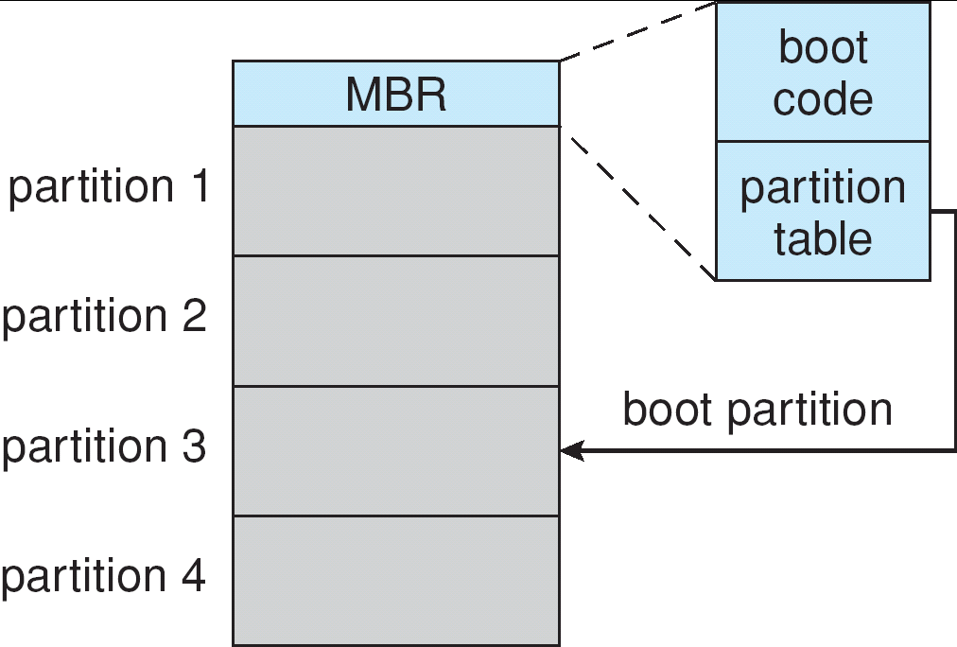
Booting from a Disk in Windows 2000

Slide 21
Swap-Space Management
Swap-space — Virtual memory uses disk space as an extension of main memory.
Swap-space can be carved out of the normal file system,or, more commonly, it can be in a separate disk partition.

Slide 22
RAID Structure
RAID – multiple disk drives provides reliability via redundancy.
RAID is arranged into six different levels.
Redundant Array of Independent/Inexpensive Disks

Slide 23
RAID (cont)
Several improvements in disk-use techniques involve the use of multiple disks working cooperatively.
Disk striping uses a group of disks as one storage unit.
RAID schemes improve performance and improve the reliability of the storage system by storing redundant data.
  Mirroring or shadowing keeps duplicate of each disk.
  Block interleaved parity uses much less redundancy.

Slide 24
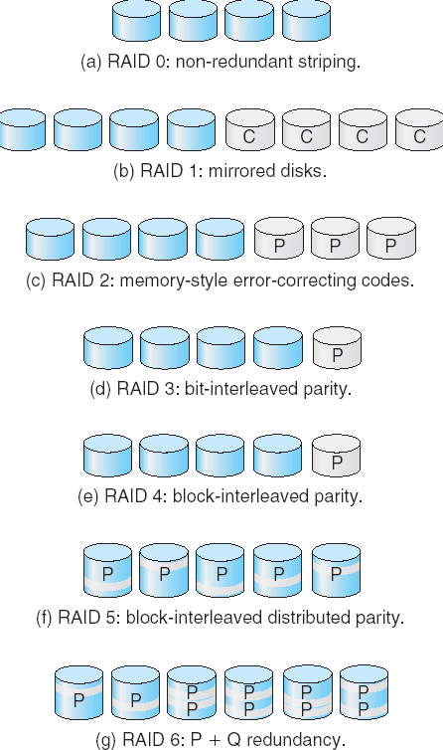
RAID Levels

Slide 25
Stable-Storage Implementation
To implement stable storage:
  Replicate information on more than one nonvolatile storage media with independent failure modes.
  Update information in a controlled manner to ensure that we can recover the stable data after any failure during data transfer or recovery.

